Slide 1

<PROJECT TITLE>
<Entrant’s Name>
<Job Title>
<Department>
<Organization>

Slide 2
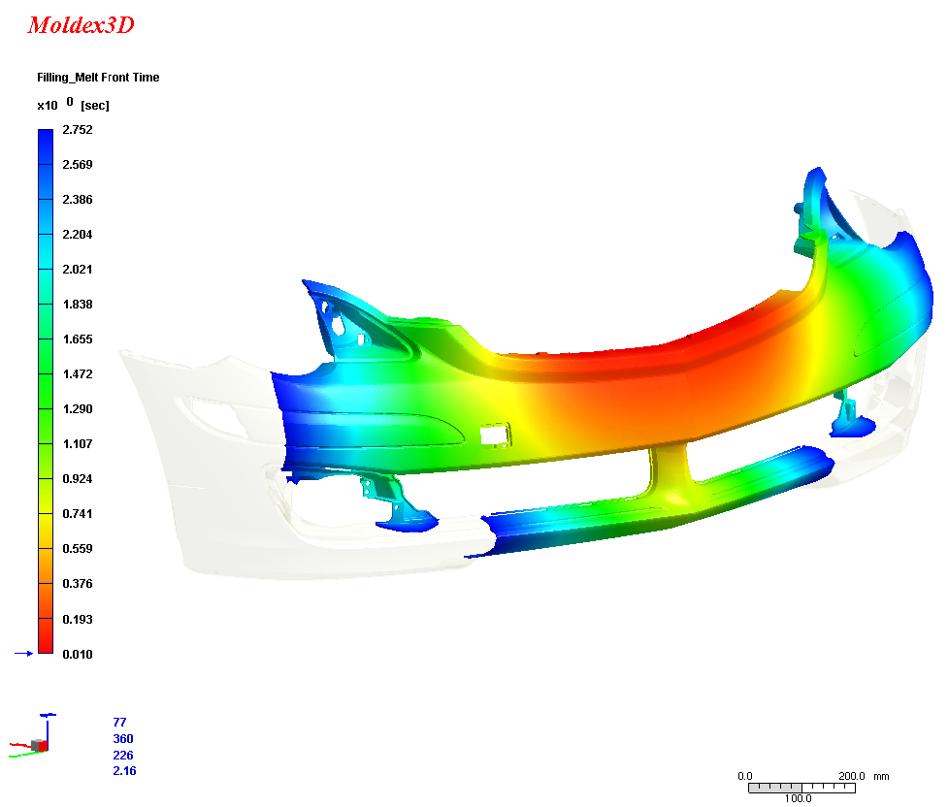
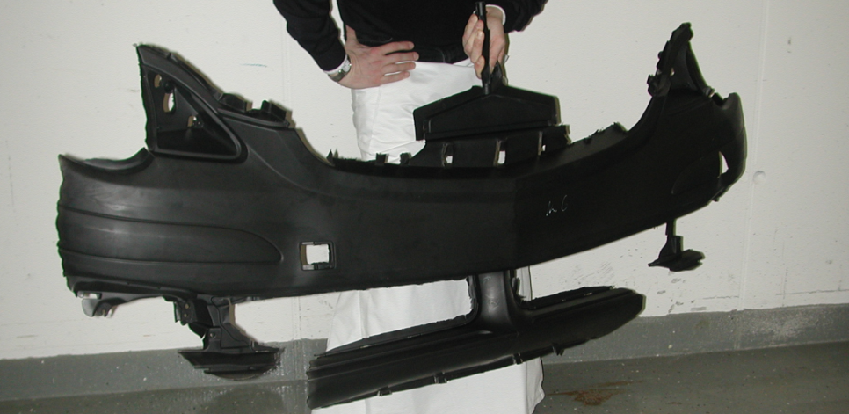
Example of Showing Images
Images should be good quality and high resolution
  Size: 1,500 x 2,100 pixels
  Minimum 300dpi
Source: BASF Polyurethanes
Must add descriptions for images.
For example: High correlation between simulation and experimental result (In a PU RIM process)

Slide 3
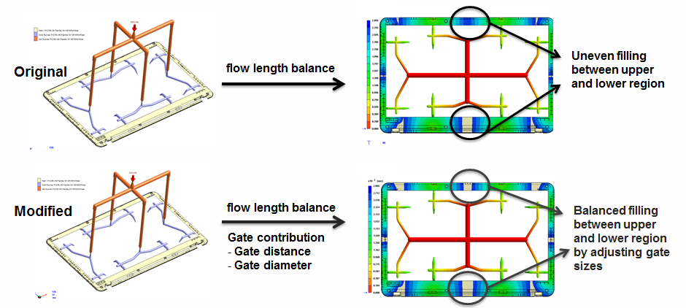
Example of Showing Images

Slide 4
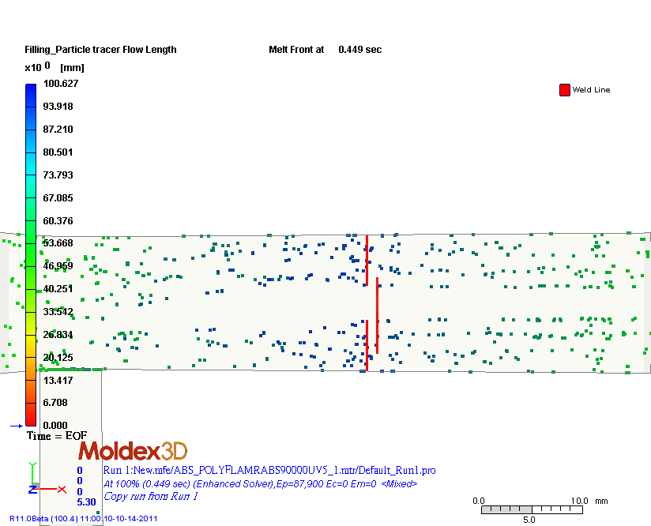
Example of Showing Videos
You can insert a URL to download the video
Or directly insert an animation
weld line

Slide 5
Table of Contents
│ Team Introduction
  Team Introduction
  Company/Institution Introduction
│ Project Introduction
  Project Background
  Project Objective
│ Product Introduction
      Product Development Process
      Part
      Material
      Process Conditions
      Runner Layouts
      Cooling Layouts
│ Simulation Analysis
  Analysis Approach
  Analysis Results
│ Results and Future Work
    Conclusions
    Future Application and Development

Slide 6
Team Introduction

Slide 7
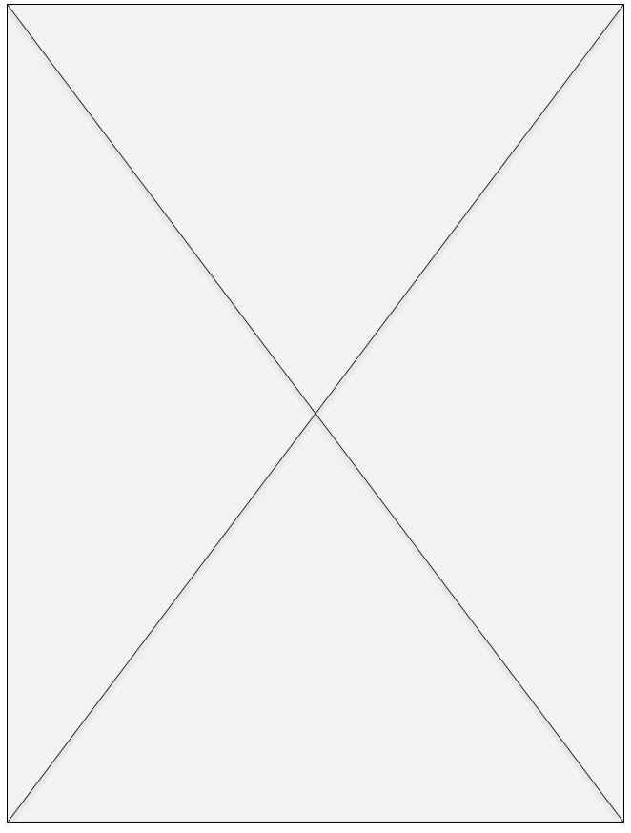
Tell Us a Bit about Yourself (Your Team)
Name:
Job Title:
Department:
Job Responsibilities:
#MyJourneytoSmartMolding Declaration:
Pictures of you or your team

Slide 8
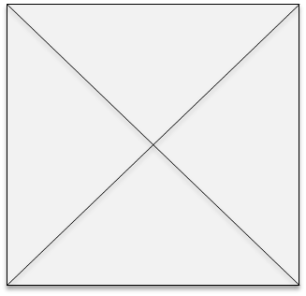
Tell Us about Where You Work (or Study)
Organization Name
Organization Description
Organization Logo
Pictures of organization

Slide 9
Project Introduction

Slide 10
Project Background
What is the design/ development trend regarding the product/ process in this project?

Slide 11
Challenges and Solutions
What challenges are you trying to solve? Why is it important to address these challenges?
Why chose Moldex3D?

Slide 12
Project Objective
Objectives
  What is the objective of the project?
Expected Results
  Explain the quantifiable results at the end of the implementation of the project ( e.g., cycle time reduced by 20.7 seconds or overall productivity enhanced by 25%)

Slide 13
Part

Slide 14
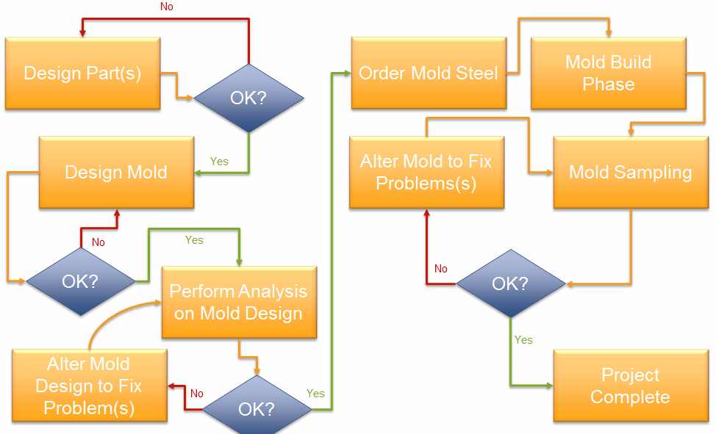
Product Development Process
Example of showing product development process

Slide 15
  Part
Product Name:
Part Dimension:
  Length： mm
  Width： mm
  Height： mm
  Thickness： mm
Mesh
  Type:
  Element Count:
Please show images of the real part

Slide 16
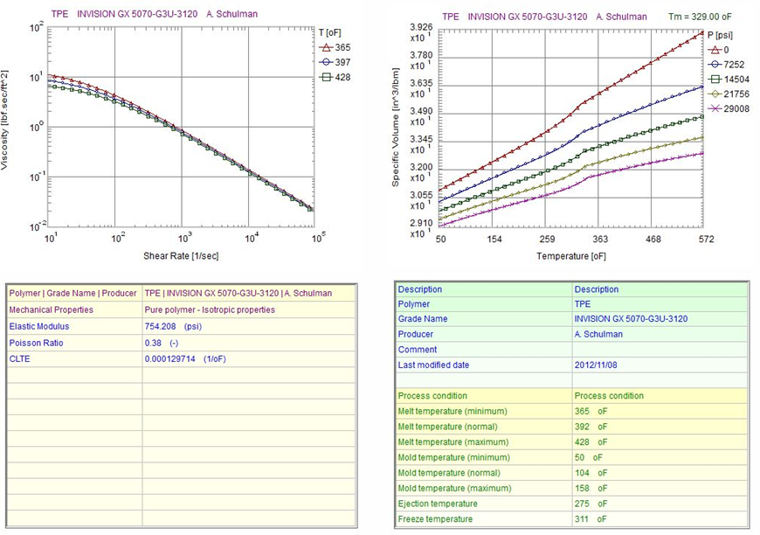
Material Details
Example of showing Material Details

Slide 17
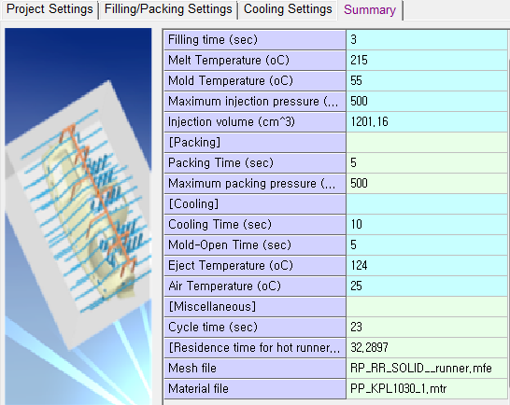
Process Conditions
Mold Temperature
  °C
Melt Temperature
  °C
Injection Time
  sec
Example of showing Process Conditions

Slide 18
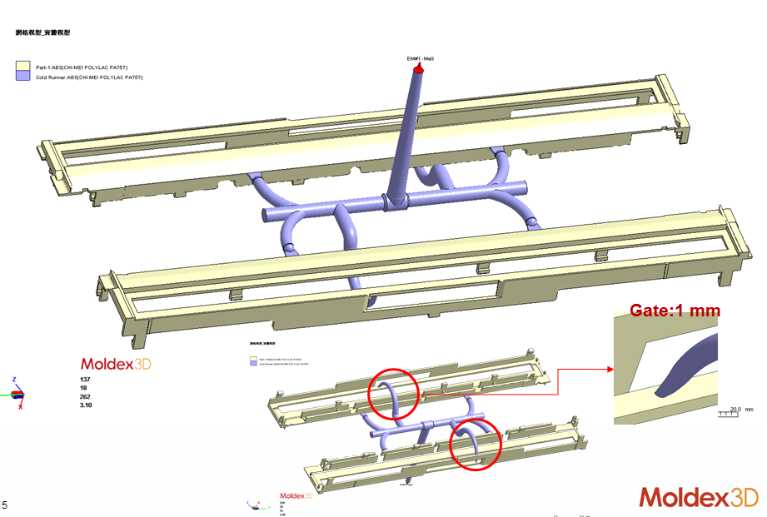
Runner System Design
Example of showing Runner System Design

Slide 19
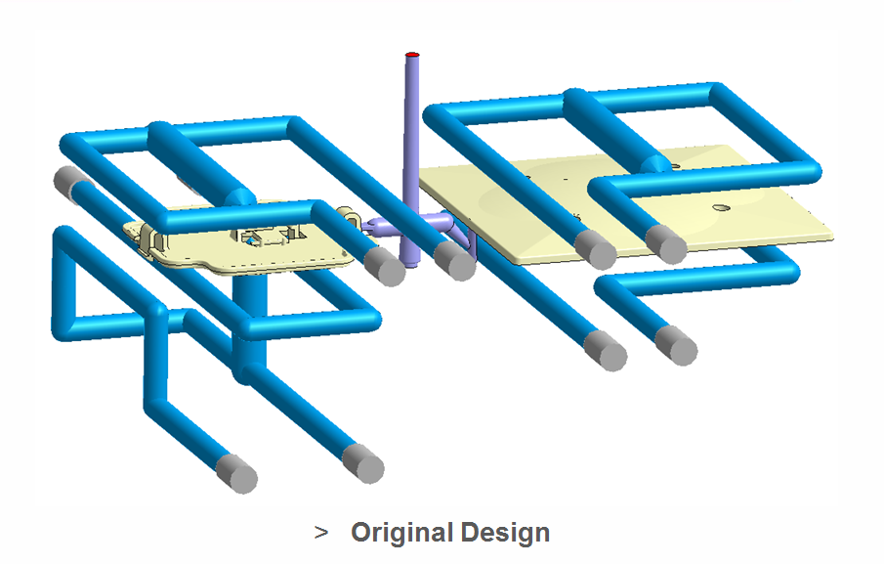
Cooling System Design/Mold Design
Example of showing Cooling System Design/Mold Design

Slide 20
Analysis Results

Slide 21
Analysis Approach
Which products/ modules you’re using in the project? Any features/ modules were particularly used?
Product Package:
  e.g., Moldex3D eDesign
Solutions/ Services
  e.g., Fiber/ FEA Interface/ Warp module/ Material characterization services
Elaborate on the analysis process and the analysis sequence.

Slide 22
Original Design Analysis Result
Please present the key analysis results of your project (e.g., melt front time, warpage analysis, fiber analysis, cooling analysis.)

Slide 23
Revised Design Analysis Result
Please present the key analysis results of your project (e.g., melt front time, warpage analysis, fiber analysis, cooling analysis.)

Slide 24
Comparison Between Original Design and Revised Design
Compare the optimized design with the original design

Slide 25
Validation on Simulation Results
Present how you validated the simulation results

Slide 26
Results and Future Work

Slide 27
Conclusion
Please summarize the project results.

Slide 28
Benefits and Values of Moldex3D
What are the benefits and values of using Moldex3D?
  Example: Sink mark elimination/Dimension control within spec./Shrinkage ratio improved by 45~60%/Flatness improved by 40~50%

Slide 29
Future Plan
Future Application of Moldex3D
Future Project Development

Slide 30
Entry Requirements
Each entry must include the following:
Project Descriptions
Project Report
Permission to Publish
OPTIONAL: Entrants are encouraged to submit CAD model(s), Part geometry (.stl or .step) and/or Mesh files (.3dm or .mdg files) for extra credit.
Entries must be sent by email to talentawards@moldex3d.com and received no later than 11:59 p.m. EST, Friday, July 31, 2020.
If your entry is too large for sending as an email attachment, upload it to your Google Drive or other service and provide us with a download link.
Incomplete entries will not be considered.
All submissions must use predominantly Moldex3D Solutions and demonstrate the benefits/ values of Moldex3D.

